Slide 1
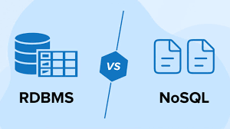
Migrating from RDBMS to MongoDB
Caleb Busch
Group 4

Slide 2

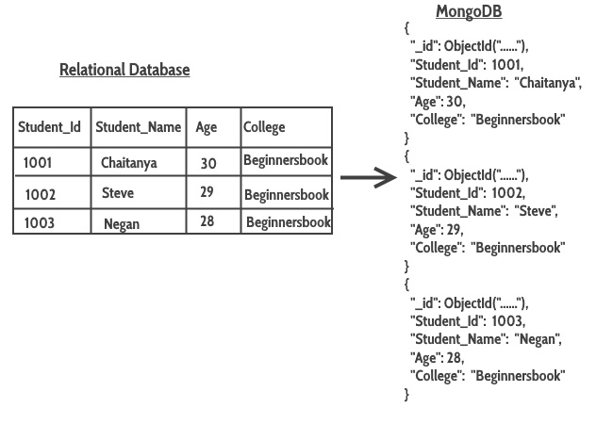
MongoDB vs RDBMS
Data Structure:
RDBMS: Organizes data in tables with fixed schemas, enforcing a structured, tabular format.
MongoDB: Stores data as flexible, JSON-like BSON documents within collections, allowing for dynamic and varied document structures.
Schema Design:
RDBMS: Requires a predefined schema, specifying the tables, relationships, and data types in advance.
MongoDB: Adopts a dynamic schema, allowing for on-the-fly changes to the structure of documents within a collection.
Query Language:
RDBMS: Utilizes SQL (Structured Query Language) for querying, joining tables, and performing complex relational operations.
MongoDB: Uses a query language based on JSON-like documents, offering a set of powerful and flexible query operators for data retrieval and manipulation.

Slide 3
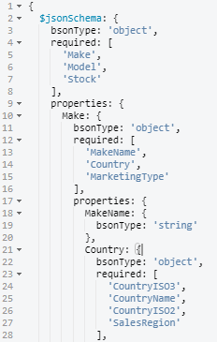
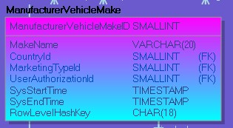
Foreign Keys → Subdocuments
Good example of how foreign keys are “replaced” with subdocuments

Slide 4
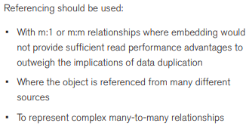
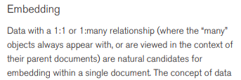
Embedding VS References
* Excerpts from a guide to migrating from RDBMS to MongoDB
Source: https://www.mongodb.com/collateral/rdbms-mongodb-migration-guide

Slide 5
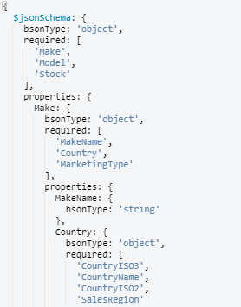
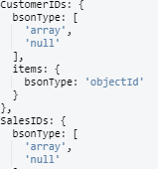
Embedding VS References (EXAMPLE)
Embedded Reference
Direct Reference

Slide 6
What is this JSON Schema?
A JSON Schema is a JSON-based format for describing the structure and validation rules for JSON documents.
So while RDBMS must have a strictly defined schema with columns and data types, JSON Schema is much more flexible, while still having the ability to validate data

Slide 7
What MongoDB Does Not Explicitly Support
-Default Values
- Must be done at the application level
-User Defined Data Types
- Must be done at the application level

Slide 8
Validation Creation Process
-Step 1: Created JSON Schema with embedded documents, specifying required and non-required fields
- for non-required fields there are no default values
-Step 2: Using an Erwin generated report for the check constraints in the SQL model, I mapped previously defined constraints to the MongoDB JSON Schema

Slide 9

Using “pattern” to mimic Check Constraints

Slide 10
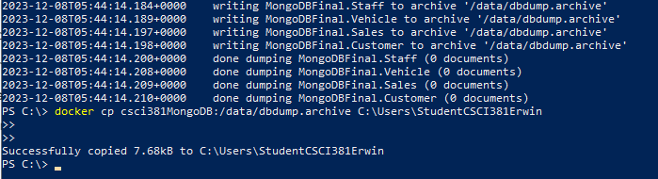
Creating a dump file in the PowerShell
-Need to create the dump inside the container, then copy to local machine
-Dump files only contain data, but not the validation information in the JSON Schema created
-The JSON Schema must be preserved manually

